Slide 1
Chapter 5: Network Layer
Introduction to Networks

Slide 2
Chapter 5: Objectives
In this chapter, you will be able to:
Explain how network layer protocols and services support communications across data networks.
Explain how routers enable end-to-end connectivity in a small-to-medium-sized business network.
Determine the appropriate device to route traffic in a small-to-medium-sized business network.
Configure a router with basic configurations.
Notes:
2
Chapter 6 Objectives

Slide 3
Chapter 6
5.1 Network Layer Protocols
5.2 Routing
5.3 Routers
5.4 Configuring a Cisco Router
5.5 Summary
Notes:
Chapter 6 Sections

Slide 4
5.1 Network Layer Protocols

Slide 5
Network Layer in Communication The Network Layer
The network layer, or OSI Layer 3, provides services to allow end devices to exchange data across the network. To accomplish this end-to-end transport, the network layer uses four basic processes:
Addressing end devices
Encapsulation
Routing
De-encapsulating

Slide 6
Network Layer in Communication Network Layer Protocols
Common network layer protocols include:
IP version 4 (IPv4)
IP version 6 (IPv6)
Legacy network layer protocols include:
Novell Internetwork Packet Exchange (IPX)
AppleTalk
Connectionless Network Service (CLNS/DECNet)

Slide 7
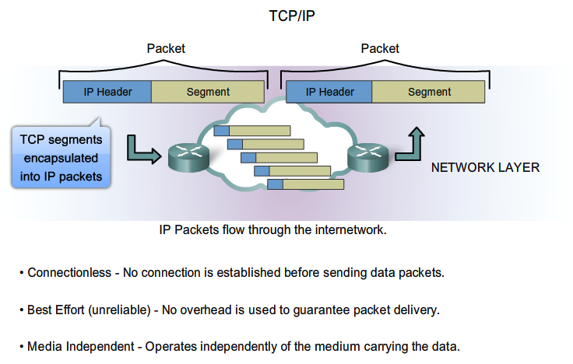
IP Characteristics IP Components

Slide 8
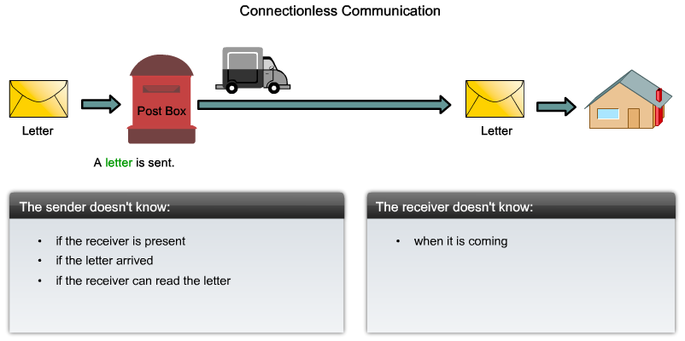
Characteristics of the IP protocol IP - Connectionless

Slide 9
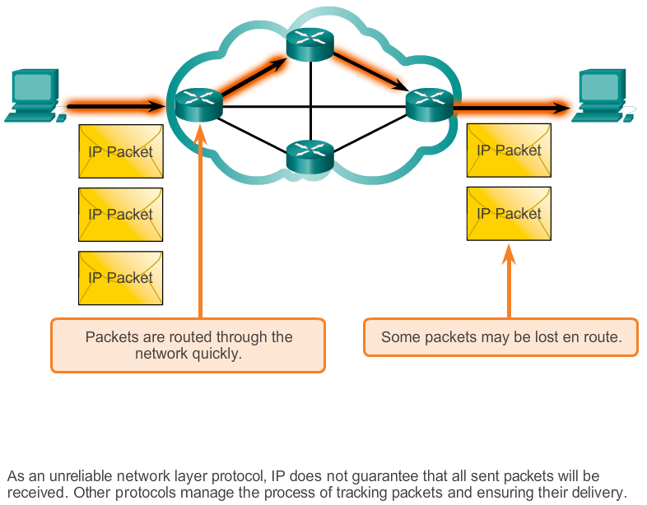
Characteristics of the IP protocol Best Effort Delivery

Slide 10
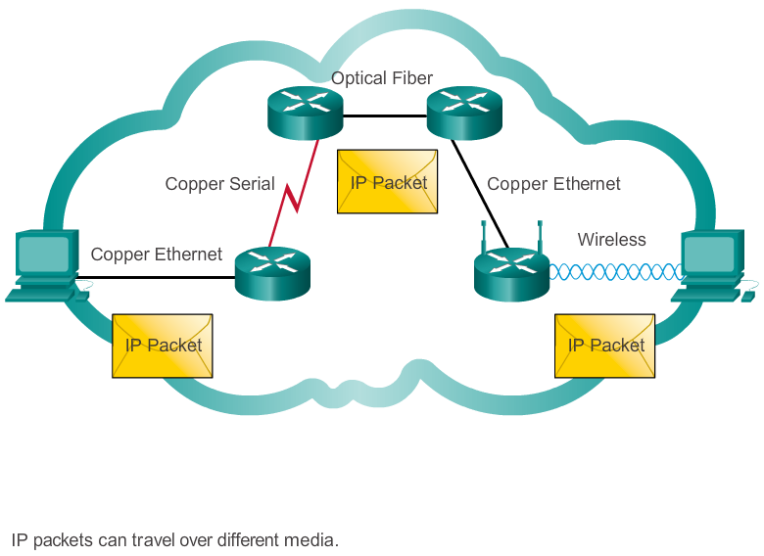
Characteristics of the IP protocol IP – Media Independent

Slide 11
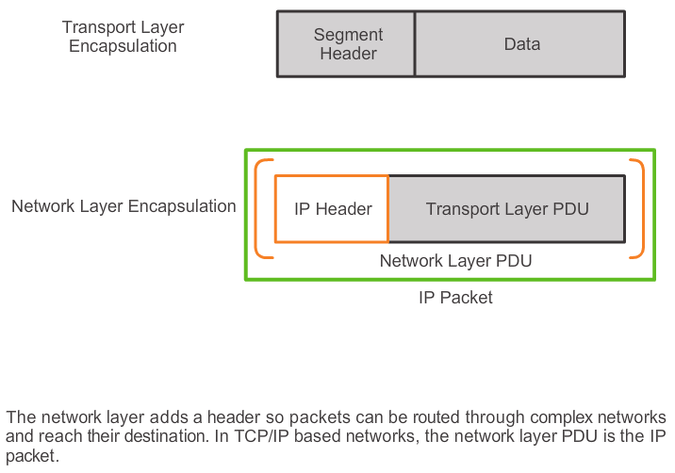
IPv4 Packet Encapsulating IP

Slide 12
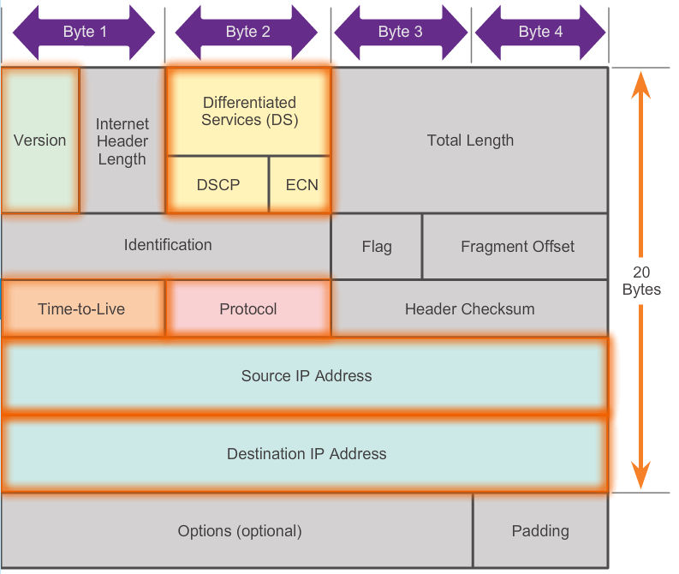
IPv4 Packet IPv4 Packet Header
Contents of the IPv4 packet header

Slide 13
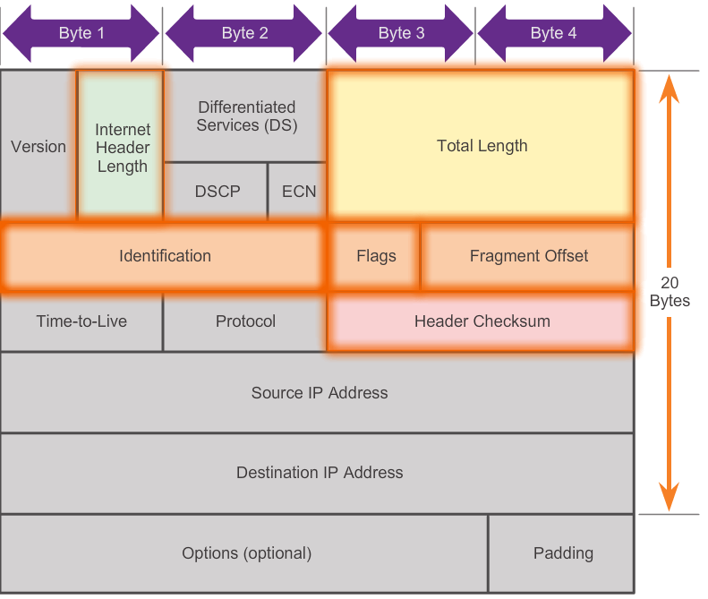
IPv4 Packet IPv4 Header Fields
Contents of the IPv4 header fields

Slide 14
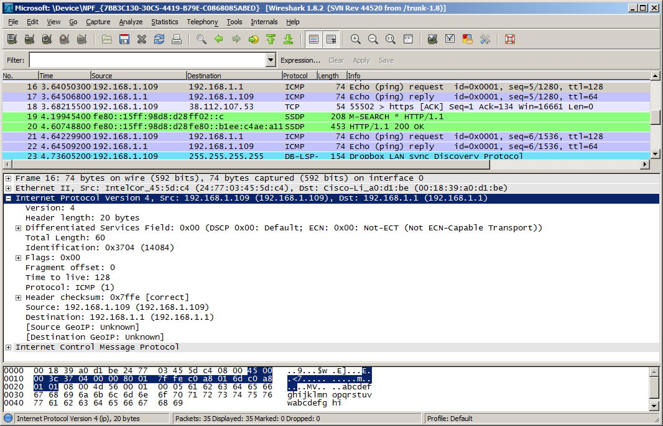
IPv4 Packet Sample IPv4 Headers
Notes:
6.1.3.3 Sample IPv4 Headers

Slide 15

Network Layer in Communication Limitations of IPv4
IP Address depletion
Internet routing table expansion
Lack of end-to-end connectivity

Slide 16
Network Layer in Communication Introducing IPv6
Increased address space
Improved packet handling
Eliminates the need for NAT
Integrated security
4 billion IPv4 addresses 4,000,000,000
340 undecillion IPv6 addresses 340,000,000,000,000,000,000,000,000,000,000,000,000

Slide 17
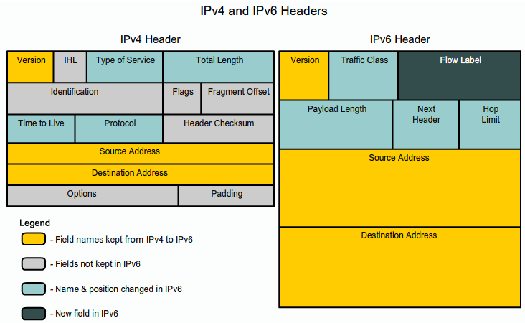
IPv6 Packet Encapsulating IPv6

Slide 18
IPv6 Packet IPv6 Packet Header
Byte 1
Byte 2
Byte 3
Byte 4
Version | Traffic Class |  | Flow Label
Payload Length |  |  |  | Next Header | Hop Limit
Source IP Address
Destination IP Address

Slide 19
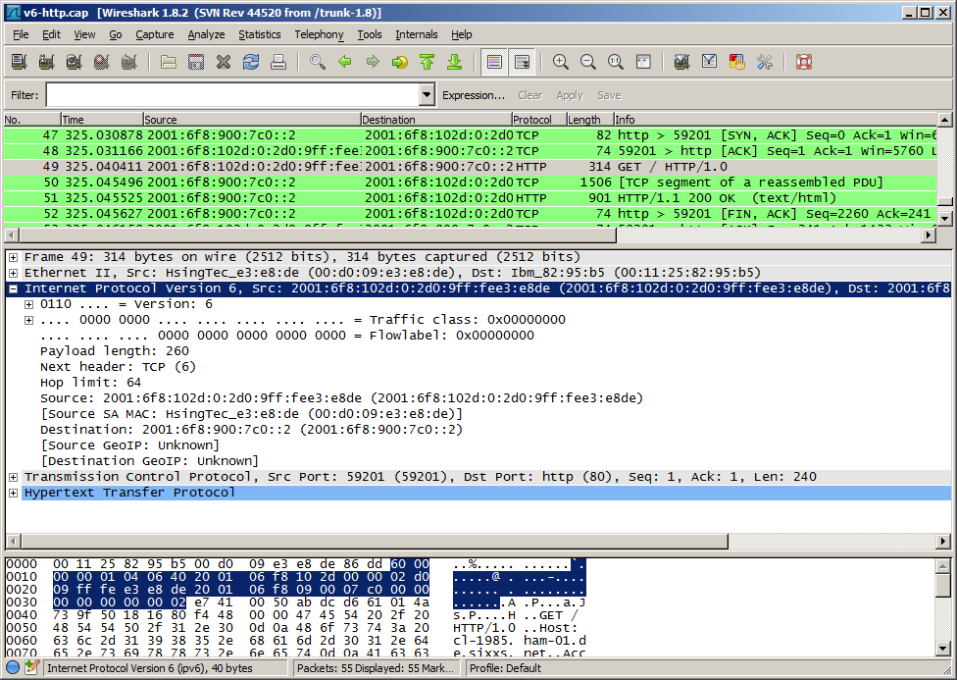
IPv6 Packet Sample IPv6 Header
Notes:
6.1.4.5 Sample IPv6 Header

Slide 20
5.2 Routing

Slide 21
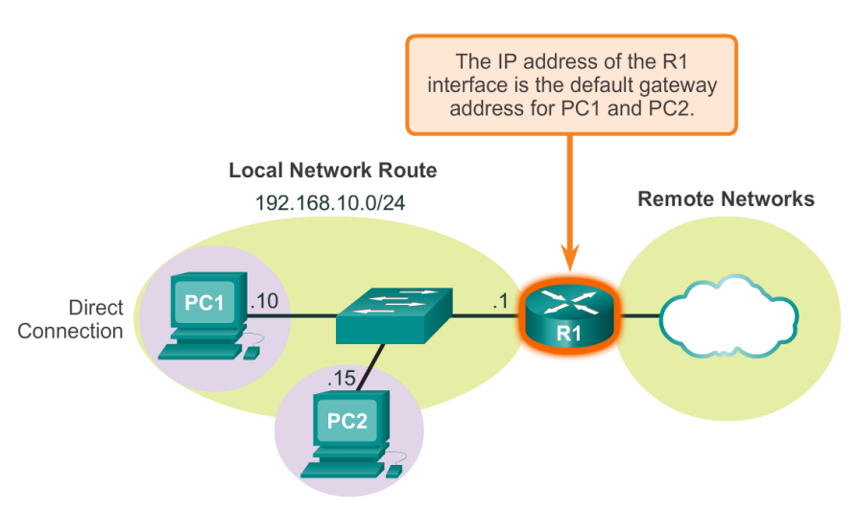
Host Routing Tables Host Packet Forwarding Decision

Slide 22
Host Routing Tables Default Gateway
Hosts must maintain their own, local, routing table to ensure that network layer packets are directed to the correct destination network. The local table of the host typically contains:
Direct connection
Local network route
Local default route
R

Slide 23
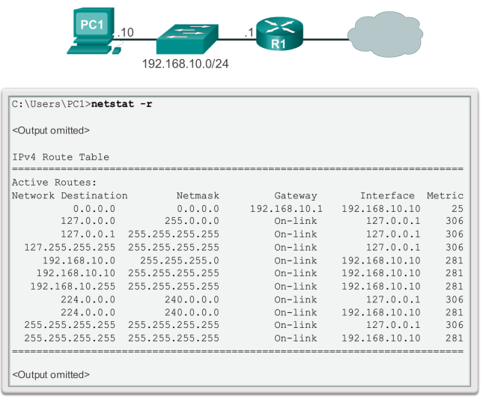
Host Routing Tables IPv4 Host Routing Table

Slide 24
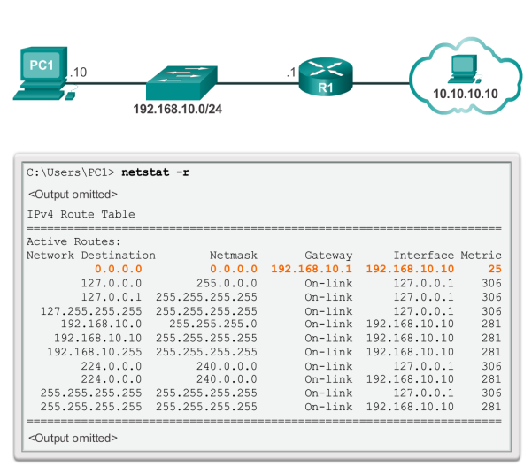
Host Routing Tables Sample IPv4 Host Routing Table

Slide 25
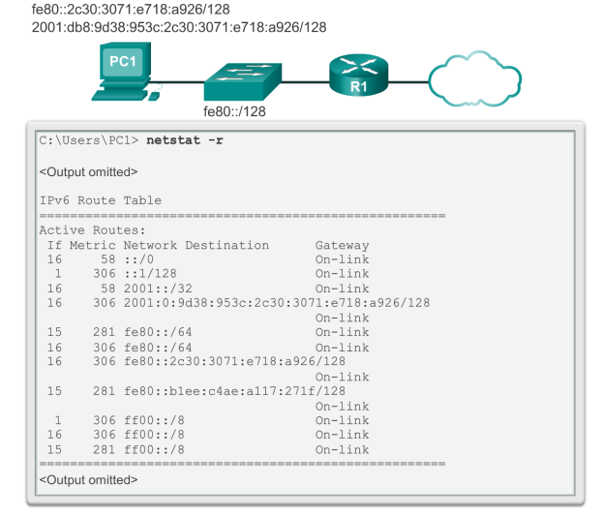
Host Routing Tables Sample IPv6 Host Routing Table
Notes:
6.2.1.6 Sample IPv6 Host Routing Table

Slide 26
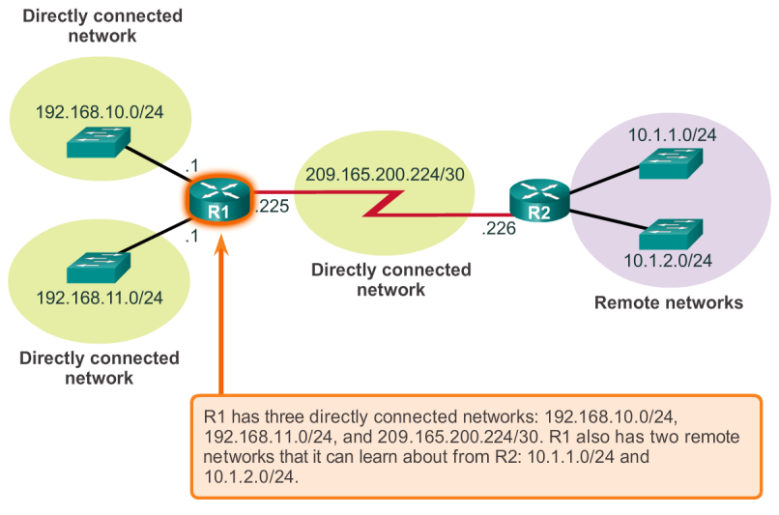
Router Routing Tables Router Packet Forwarding Decision

Slide 27
Router Routing Tables IPv4 Router Routing Table
192.168.10.0/24
10.1.1.0/24
PC1
.10
G0/0
.1
209.165.200.224 /30
.10
.1
R1
.225
S0/0/0
.226
R2
.10
.1
G0/1
.1
.10
PC2
192.168.11.0/24
10.1.2.0/24
R1#show ip route
Codes: L - local, C - connected, S - static, R - RIP, M - mobile, B - BGP
D - EIGRP, EX - EIGRP external, O - OSPF, IA - OSPF inter area
N1 - OSPF NSSA external type 1, N2 - OSPF NSSA external type 2
E1 - OSPF external type 1, E2 - OSPF external type 2, E - EGP
i - IS-IS, L1 - IS-IS level-1, L2 - IS-IS level-2, ia - IS-IS inter area
* - candidate default, U - per-user static route, o - ODR
P - periodic downloaded static route
Gateway of last resort is not set
10.0.0.0/8 is variably subnetted, 2 subnets, 2 masks
D 10.1.1.0/24 [90/2170112] via 209.165.200.226, 00:00:05, Serial0/0/0
D 10.1.2.0/24 [90/2170112] via 209.165.200.226, 00:00:05, Serial0/0/0
192.168.10.0/24 is variably subnetted, 2 subnets, 3 masks
C 192.168.10.0/24 is directly connected, GigabitEthernet0/0
L 192.168.10.1/32 is directly connected, GigabitEthernet0/0
192.168.11.0/24 is variably subnetted, 2 subnets, 3 masks
C 192.168.11.0/24 is directly connected, GigabitEthernet0/1
L 192.168.11.1/32 is directly connected, GigabitEthernet0/1
209.165.200.0/24 is variably subnetted, 2 subnets, 3 masks
C 209.165.200.224/30 is directly connected, Serial0/0/0
L 209.165.200.225/32 is directly connected, Serial0/0/0
R1#

Slide 28
Router Routing Tables Directly Connected Routing Table Entries
192.168.10.0/24
64.100.0.1
10.1.1.0/24
PC1
.10
G0/0
.1
209.165.200.224 /30
.10
.1
R1
.225
S0/0/0
.226
R2
.10
.1
G0/1
.1
.10
PC2
192.168.11.0/24
10.1.2.0/24
A
B
C
C 192.168.10.0/24 is directly connected, GigabitEthernet0/0
L 192.168.10.1/32 is directly connected, GigabitEthernet0/0
A | Identifies how the network was learned by the router.
B | Identifies the destination network and how it is connected.
C | Identifies the interface on the router connected to the destination network.

Slide 29
Router Routing Tables Remote Network Routing Table Entries
192.168.10.0/24
64.100.0.1
10.1.1.0/24
PC1
.10
G0/0
.1
209.165.200.224 /30
.10
.1
R1
.225
S0/0/0
.226
R2
.10
.1
G0/1
.1
.10
PC2
192.168.11.0/24
10.1.2.0/24
D 10.1.1.0/24 [90/2170112] via 209.165.200.226, 00:00:05, Serial0/0/0
A | Identifies how the network was learned by the router.
B | Identifies the destination network.
C | Identifies the administrative distance (trustworthiness) of the route source.
D | Identifies the metric to reach the remote network.
E | Identifies the next hop IP address to reach the remote network.
F | Identifies the amount of elapsed time since the network was discovered.
G | Identifies the outgoing interface on the router to reach the destination network.

Slide 30
Router Routing Tables Next-Hop Address
192.168.10.0/24
64.100.0.1
10.1.1.0/24
PC1
.10
G0/0
.1
209.165.200.224 /30
.10
.1
R1
.225
S0/0/0
.226
R2
.10
.1
G0/1
.1
.10
PC2
192.168.11.0/24
10.1.2.0/24
R1#show ip route
Codes: L - local, C - connected, S - static, R - RIP, M - mobile, B - BGP
D - EIGRP, EX - EIGRP external, O - OSPF, IA - OSPF inter area
N1 - OSPF NSSA external type 1, N2 - OSPF NSSA external type 2
E1 - OSPF external type 1, E2 - OSPF external type 2, E - EGP
i - IS-IS, L1 - IS-IS level-1, L2 - IS-IS level-2, ia - IS-IS inter area
* - candidate default, U - per-user static route, o - ODR
P - periodic downloaded static route
Gateway of last resort is not set
10.0.0.0/8 is variably subnetted, 2 subnets, 2 masks
D 10.1.1.0/24 [90/2170112] via 209.165.200.226, 00:00:05, Serial0/0/0
D 10.1.2.0/24 [90/2170112] via 209.165.200.226, 00:00:05, Serial0/0/0
192.168.10.0/24 is variably subnetted, 2 subnets, 3 masks
C 192.168.10.0/24 is directly connected, GigabitEthernet0/0
L 192.168.10.1/32 is directly connected, GigabitEthernet0/0
192.168.11.0/24 is variably subnetted, 2 subnets, 3 masks
C 192.168.11.0/24 is directly connected, GigabitEthernet0/1
L 192.168.11.1/32 is directly connected, GigabitEthernet0/1
209.165.200.0/24 is variably subnetted, 2 subnets, 3 masks
C 209.165.200.224/30 is directly connected, Serial0/0/0
L 209.165.200.225/32 is directly connected, Serial0/0/0
R1#
Notes:
6.2.2.5 Next-Hop Address

Slide 31
Configure Initial Settings Router Configuration Steps
192.168.10.0/24
10.1.1.0/24
PC1
.10
G0/0
.1
209.165.200.224 /30
.10
.1
R1
.225
S0/0/0
.226
R2
.10
.1
G0/1
.1
.10
PC2
192.168.11.0/24
10.1.2.0/24
Router> enable
Router# configure terminal
Enter configuration commands, one per line. End with CNTL/Z.
Router(config)# hostname R1
R1(config)#
Router> en
Router# conf t
Enter configuration commands, one per line. End with CNTL/Z.
Router(config)# ho R1
R2(config)#
OR
R1(config)# enable secret class
R1(config)#
R1(config)# line console 0
R1(config-line)# password cisco
R1(config-line)# login
R1(config-line)# exit
R1(config)#
R1(config)# line vty 0 4
R1(config-line)# password cisco
R1(config-line)# login
R1(config-line)# exit
R1(config)#
R1(config)# service password-encryption
R1(config)#
R1(config)# banner motd #
Enter TEXT message. End with the character '#'.
***********************************************
WARNING: Unauthorized access is prohibited!
***********************************************
#
R1(config)#
R1# copy running-config startup-config
Destination filename [startup-config]?
Building configuration...
[OK]
R1#
Notes:
6.4.1.1 Router Configuration Steps

Slide 32
Configure Interfaces Configure LAN Interfaces
192.168.10.0/24
10.1.1.0/24
PC1
.10
G0/0
.1
209.165.200.224 /30
.10
.1
R1
.225
S0/0/0
.226
R2
.10
.1
G0/1
.1
.10
PC2
192.168.11.0/24
10.1.2.0/24
R1# conf t
Enter configuration commands, one per line. End with CNTL/Z.
R1(config)#
R1(config)# interface gigabitethernet 0/0
R1(config-if)# ip address 192.168.10.1 255.255.255.0
R1(config-if)# description Link to LAN-10
R1(config-if)# no shutdown
%LINK-5-CHANGED: Interface GigabitEthernet0/0, changed state to up
%LINEPROTO-5-UPDOWN: Line protocol on Interface GigabitEthernet0/0, changed state to up
R1(config-if)# exit
R1(config)#
R1(config)# int g0/1
R1(config-if)# ip add 192.168.11.1 255.255.255.0
R1(config-if)# des Link to LAN-11
R1(config-if)# no shut
%LINK-5-CHANGED: Interface GigabitEthernet0/1, changed state to up
%LINEPROTO-5-UPDOWN: Line protocol on Interface GigabitEthernet0/1, changed state to up
R1(config-if)# exit
R1(config)#
Notes:
6.4.2.1 Configure LAN Interfaces

Slide 33
Configure Interfaces Verify Interface Configuration
192.168.10.0/24
10.1.1.0/24
PC1
.10
G0/0
.1
209.165.200.224 /30
.10
.1
R1
.225
S0/0/0
.226
R2
.10
.1
G0/1
.1
.10
PC2
192.168.11.0/24
10.1.2.0/24
R1# show ip interface brief
Interface IP-Address OK? Method Status Protocol
GigabitEthernet0/0 192.168.10.1 YES manual up up
GigabitEthernet0/1 192.168.11.1 YES manual up up
Serial0/0/0 209.165.200.225 YES manual up up
Serial0/0/1 unassigned YES NVRAM administratively down down
Vlan1 unassigned YES NVRAM administratively down down
R1#
R1# ping 209.165.200.226
Type escape sequence to abort.
Sending 5, 100-byte ICMP Echos to 209.165.200.226, timeout is 2 seconds:
!!!!!
Success rate is 100 percent (5/5), round-trip min/avg/max = 1/2/9 ms
R1#
Notes:
6.4.2.2 Verify Interface Configuration

Slide 34
Configuring the Default Gateway Default Gateway on a Host
Default Gateway not needed
PC1
.10
192.168.10.0/24
.1
G0/0
Default Gateway needed
PC2
.10
R1
G0/1
.1
PC1
.10
192.168.10.0/24
.1
G0/0
.10
PC2
.11
PC3
R1
.10
192.168.11.0/24
G0/1
.1
PC4
PC3
.10
.11
192.168.11.0/24
PC4
Notes:
6.4.3.1 Default Gateway on a Host

Slide 35
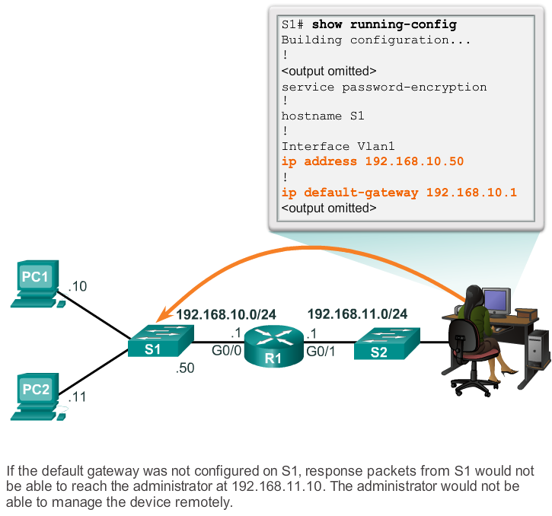
Configuring the Default Gateway Default Gateway on a Switch
Notes:
6.4.3.2 Default Gateway on a Switch

Slide 36
Network Layer Summary
In this chapter, you learned:
The network layer, or OSI Layer 3, provides services to allow end devices to exchange data across the network.
The network layer uses four basic processes: IP addressing for end devices, encapsulation, routing, and de-encapsulation.
The Internet is largely based on IPv4, which is still the most widely-used network layer protocol.
An IPv4 packet contains the IP header and the payload.
The IPv6 simplified header offers several advantages over IPv4, including better routing efficiency, simplified extension headers, and capability for per-flow processing.
Notes:
Chapter 6 Summary

Slide 37
Network Layer Summary (cont.)
In addition to hierarchical addressing, the network layer is also responsible for routing.
Hosts require a local routing table to ensure that packets are directed to the correct destination network.
The local default route is the route to the default gateway.
The default gateway is the IP address of a router interface connected to the local network.
When a router, such as the default gateway, receives a packet, it examines the destination IP address to determine the destination network.
Notes:
Chapter 6 Summary (cont.)

Slide 38
Network Layer Summary (cont.)
The routing table of a router stores information about directly-connected routes and remote routes to IP networks. If the router has an entry in its routing table for the destination network, the router forwards the packet. If no routing entry exists, the router may forward the packet to its own default route, if one is configured or it will drop the packet.
Routing table entries can be configured manually on each router to provide static routing or the routers may communicate route information dynamically between each other using a routing protocol.
For routers to be reachable, the router interface must be configured.
Notes:
Chapter 6 Summary (cont.)

Slide 39


